Slide 1
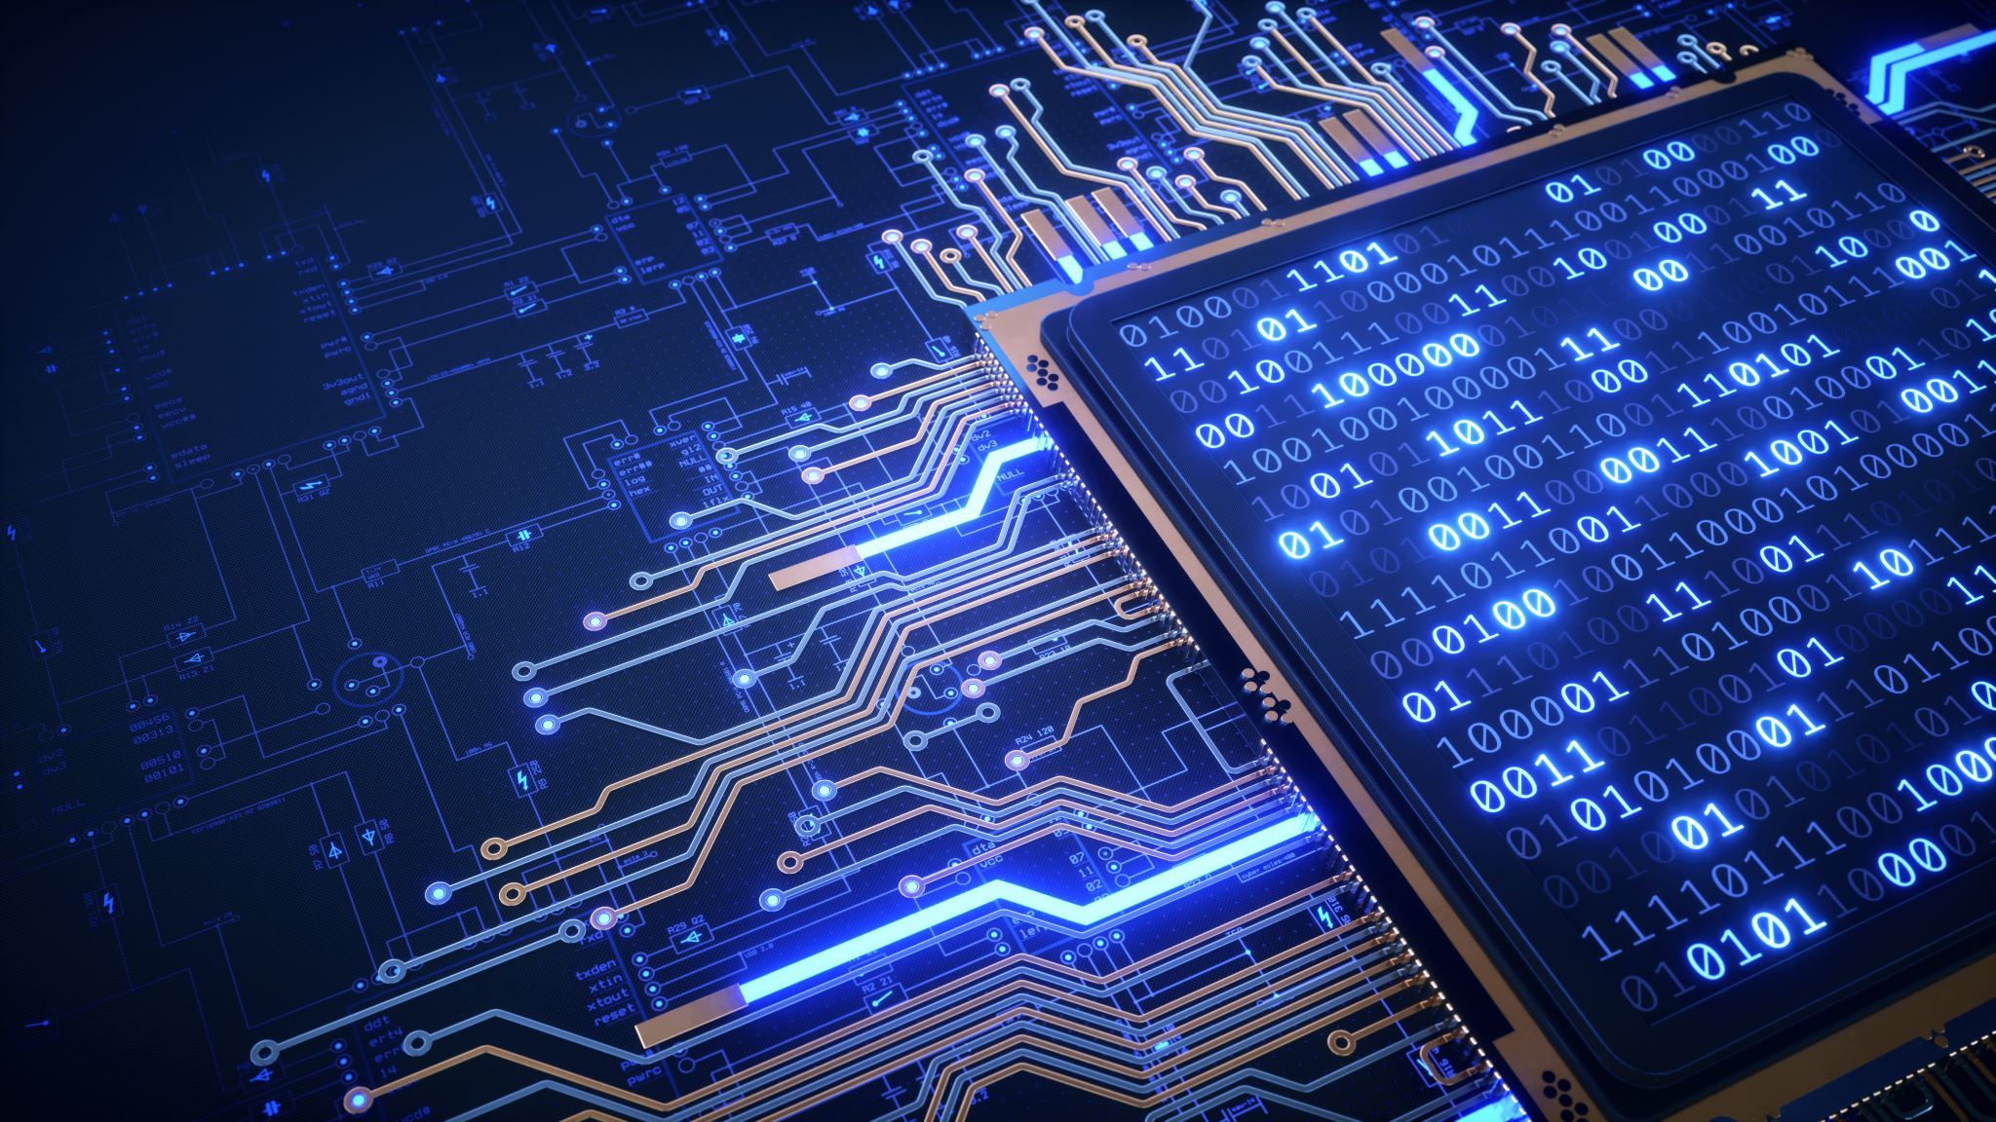
Computer Networks
Introduction to data communication & Computer networks

Slide 2
Class & Office Hours
Section A:
Monday 2:10 PM – 3:30 PM
Wednesday 12:30 PM – 1:50 PM
Section B:
Tuesday 9:30 AM – 11:00 AM
Thursday 11:00 AM – 12:30 PM
Office Hours:
Tuesday & Wednesday 11:00 AM – 12:00 PM

Slide 3
About Me
Mashal Khan
BS Computer Systems Engineering (UET Peshawar)
MS Information Security (NUST Islamabad)
Email: mashal.khan@nu.edu.pk

Slide 4
Books and Relevant Content
Data communications and networking by Behrouz A. Forouzan
Data and Computer Communications by William Stallings
Software Defined Networks
Reading materials and Articles
Reference Slide at the end of every lecture to make your life easier ☺

Slide 5
Evaluations
Assessment | Weightage (%age)
Assignments / Case Studies | 10
Quizzes | 10
Project | 10
Sessional 1 | 15
Sessional 2 | 15
Finals | 40

Slide 6
Introduction
What is networks?
Its importance
Major areas of Application
Industry Application/usage
Softwares used
Major Research Areas.
Notes:
Hype words in the field of networks
SDN , 5G etc, Optic fibre

Slide 7
Today’s Topics
Data and Data Communication
Effectiveness
Components
Data Flow
Networks
Criteria
Structure
Topologies
Categories
Types
Notes:
Today’s goal is to get a little bit of familiarization with these keywords. No worries if you aren’t getting things now. Just listen and you will understand things with the passage of time

Slide 8
Data Communication
Networks exist so that data may be sent from one place to another.
Telecommunication network that allows computers to exchange data.
Connection between the exchanging devices can be wired or wireless.
Best known Computer network is Internet.
Notes:
In general refers to group of people sharing information among themselves. E.g. Alumni network, Social network etc. Similary used in computer world .

Slide 9
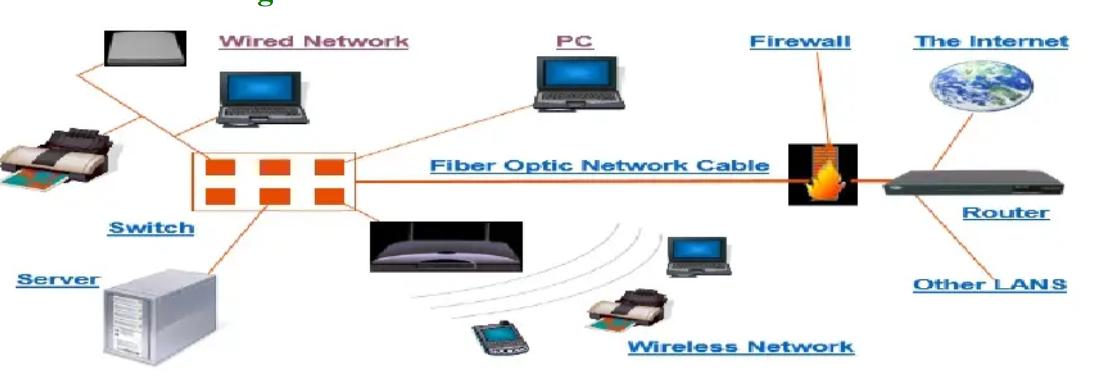
A system containing any combination of computers, computer terminals, printers, audio or visual display devices, or telephones interconnected by telecommunication equipment or cables: used to transmit or receive information.

Slide 10
Data Communication
When we communicate we share information
Local Communication, if Face to Face
Remote (tele), if through Telephone, Telex, television etc
Data
Information presented in any form that is agreed upon by communicating parties.
Text, Image, Video, Audio
Notes:
Networking in events, Exchange of useful information

Slide 11
Exchange of data between two devices via some form of transmission medium such as a wire or wireless
Data Communication is the exchange of information from One entity to another using a transmission medium
Keywords
Exchange
Information
Entity
Transmission medium

Slide 12
Effectiveness of a Data Communications
The effectiveness of a data communications system depends on four fundamental characteristics:
Delivery,
Accuracy,
Timeliness, and
Jitter.
Notes:
Suppose a network analyst is asked to check the network. Some metrics are required

Slide 13
Delivery: The system must deliver data to the correct destination. Data must be received by the only intended device or user.
Accuracy: The system must deliver the data accurately. Data that have been altered in transmission and left uncorrected are unusable.
Timeliness: The system must deliver data in a timely manner. Data delivered late are useless. In the case of video and audio, timely delivery means delivering data as they are produced, in the same order that they are produced, and without significant delay. This kind of delivery is called real-time transmission.
Jitter: Jitter refers to the variation in the packet arrival time. It is the uneven delay in the delivery of audio or video packets. For example, let us assume that video packets are sent every 3 ms. If some of the packets arrive with 3 ms delay and others with 4 ms delay, an uneven quality in the video is the result.

Slide 14
Components
Five basic Components of data communication
Message
Sender
Reciever
Transmission medium
Protocol

Slide 15
Message: The message is the information (data) to be communicated.
Sender/ Receiver: The sender/receiver is the device that sends/receives the data message.
Transmission medium: The transmission medium is the physical path by which a message travels from sender to receiver.
Protocol: A protocol is a set of rules that govern data communications.
Notes:
Example of telephone, LAN Messanger
Message: The message is the information (data) to be communicated. Popular forms of information include text, numbers, pictures, audio, and video.
Sender/ Receiver: The sender/receiver is the device that sends/receives the data message. It can be a computer, workstation, telephone handset, video camera, and so on.
Transmission medium: The transmission medium is the physical path by which a message travels from sender to receiver. Such as twisted-pair wire, coaxial cable, fiber-optic cable, and radio waves.
Protocol. A protocol is a set of rules that govern data communications. It represents an agreement between the communicating devices. Without a protocol, two devices may be connected but not communicating, just as a person speaking French cannot be understood by a person who speaks only Japanese.

Slide 16
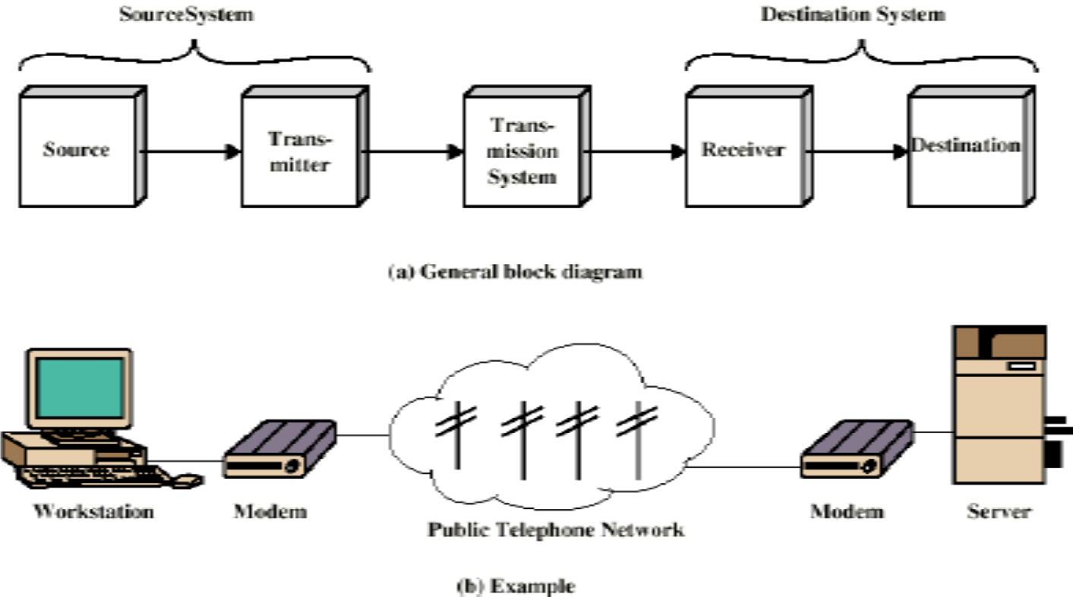
Communication Model

Slide 17
Parts of Communication Model
Source
Generates data to be transmitted
Telephone, Mic, Computer, Web Cam, Scanner, Digital Camera
Transmitter
Data produced can not be transmitted directly
Data should be converted to signals
Transmitter converts data into transmittable signals
Modem converts Data Bits into Signals
Modulation

Slide 18
Parts of Communication Model
Transmission System
It carries data from one party (sender) to another (receiver)
Can be Wired / Wireless medium
Can be complex network like Internet
Receiver
It receives signal
Converts received signal into data (bits)
Modem (demodulation)
Destination
Takes incoming data from receiver.

Slide 19
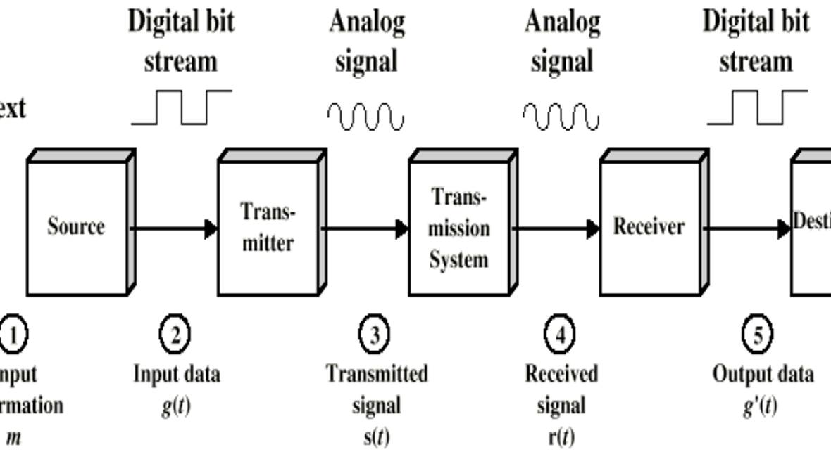

Slide 20
Types of Communication or Connections Directions of Data Flow
Communication modes could be:
Simplex
One Way (Uni directional) only
One device is sender and other is receiver
Monitor, Speakers, Bluetooth devices etc
Is Keyboard Simplex?
Half Duplex
Bi-directional
Only One device can send at a time and other will receive
Traditional Wireless Sets
Full Duplex
Bi-Directional
Both Devices can send/Receive simultaneously
Telephone Network
Notes:
Bluetooth devices

Slide 21
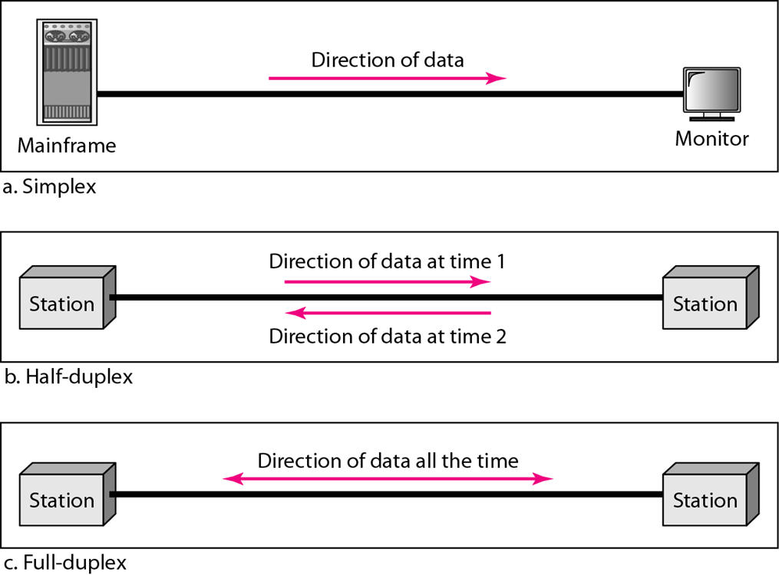

Slide 22
Networks
A network is a set of devices (often referred to as nodes) connected by communication links.
A node can be a computer, printer, or any other device capable of sending and/or receiving data generated by other nodes on the network.
A link can be a cable, air, optical fiber, or any medium which can transport a signal carrying information.
Network Criteria
Physical Structures
Categories of Networks
Notes:
Node= end users
Link= communication media

Slide 23
Network Criteria
Performance
Depends on Network Elements
Measured in terms of Delay and Throughput
Reliability
Failure rate of network components
Measured in terms of availability/robustness
Security
Data protection against corruption/loss of data due to:
Errors
Malicious users

Slide 24
Physical Structure
Type of Connection
Point to Point -single transmitter and receiver
Multipoint -multiple recipients of single transmission
Physical Topology
Connection of devices
Type of transmission -unicast, mulitcast, broadcast

Slide 25
Point to point Connection
Point to point communication not usually practical
Dedicated link between two devices.
Entire capacity of the link is reserved for transmission between those two devices.
Most point-to-point connections use an actual length of wire or cable to connect the two ends, but other options, such as microwave or satellite links, are also possible
Devices are too far apart
Large set of devices would need impractical number of connections
Solution is a Communications Network
Attach all devices to a communication network
Notes:
When you change television channels by infrared remote control,
you are establishing a point-to-point connection between the remote control and the
television's control system.

Slide 26
Multi Point Connection
Also called multidrop
More than two specific devices share a single link
The capacity of the channel is shared, either spatially or temporally.
If several devices can use the link simultaneously, it is a spatially shared connection.
If users must take turns, it is a timeshared connection.

Slide 27
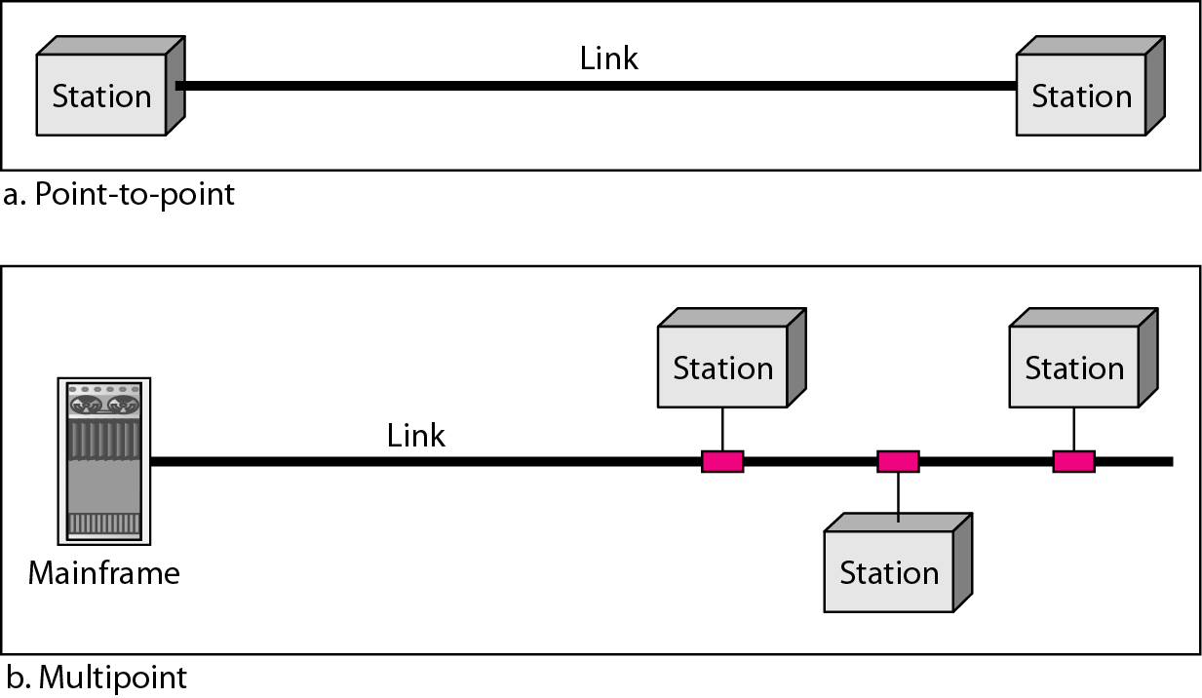

Slide 28

Physical Topology
Topology dictates that how nodes are physically connected in a network
Geometric representation of relationship of all the links and linking devices
Four basic topologies:
Mesh
Star
Bus
Ring

Slide 29
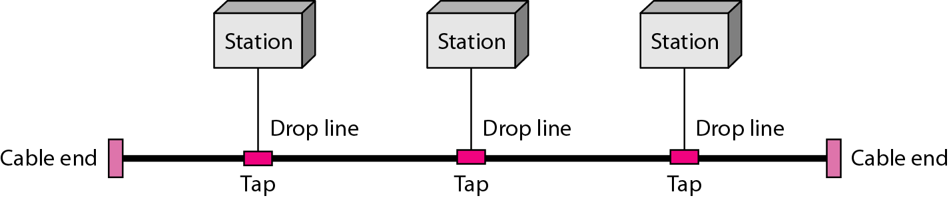
Topology: Bus
A Bus Topology connecting three stations

Slide 30
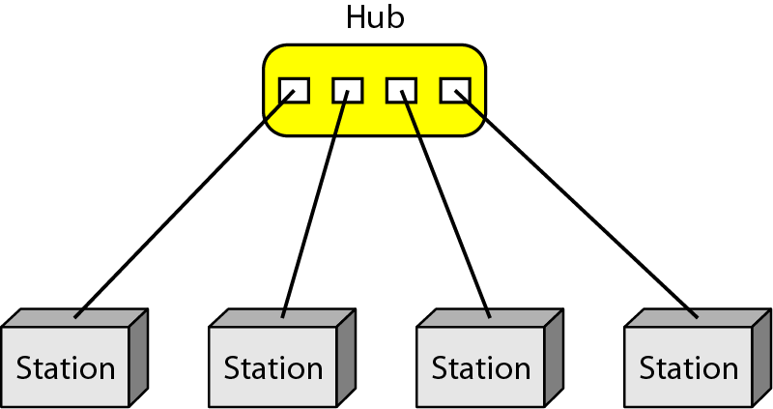
Topology: Star
A star topology connecting four stations through a central device (hub)

Slide 31
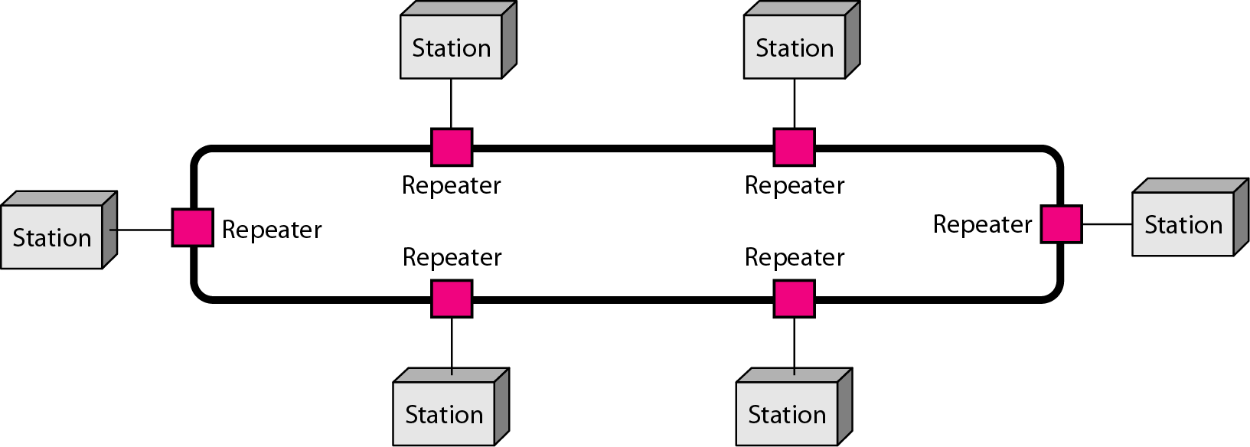
Topology: Ring
A Ring Topology connecting six stations

Slide 32
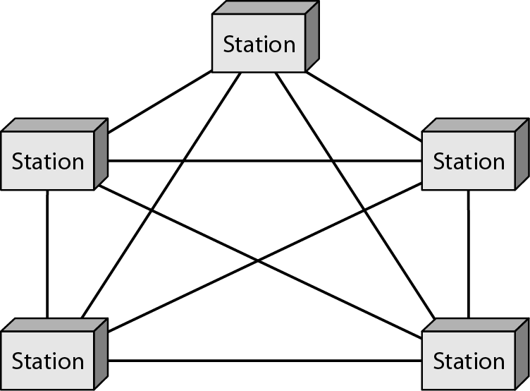
Topology: Fully Connected Mesh
All the stations have a P-to-P link with all other stations in the network

Slide 33
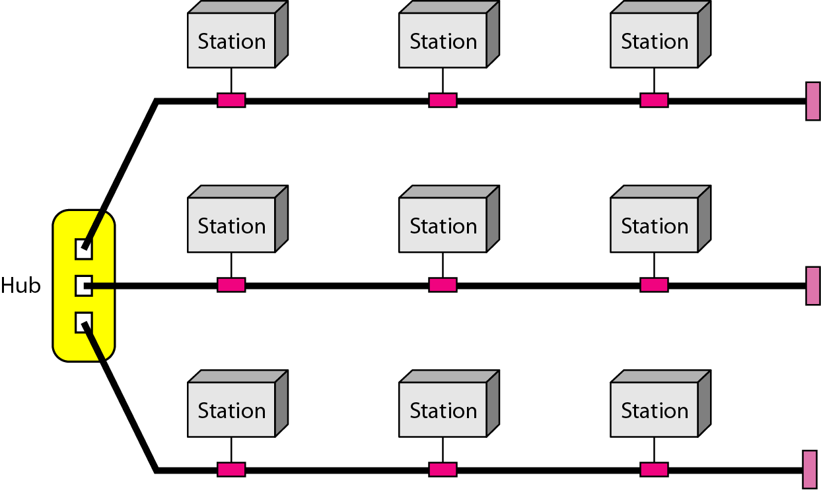
Hybrid Topology
Topology that is constituted by integrating more than one topology

Slide 34
Assignment
Compare and contrast Network Topologies (Advantages and Disadvantages)
Star
Mesh
Hybrid
Bus
Ring
Tree
Find and explain practical examples for each of them(At least 2 each).
Any other possible topology?

Slide 35
Categories of Network
Local Area Networks (LANs)
Short distances
Designed to provide local interconnectivity
Wide Area Networks (WANs)
Long distances
Provide connectivity over large areas
Metropolitan Area Networks (MANs)
Provide connectivity over areas such as a city, a campus
Notes:
There are some more categories MAN, DAN, PAN etc

Slide 36
Local Area Network (LAN)
Smaller scope
Building or small campus
Usually owned by served organization/company
Data rates much higher
Traditionally it used broadcast systems instead of switched approach
Now switched systems (Ethernet) and ATM (ATM LANs) have replaced broadcasting hubs

Slide 37
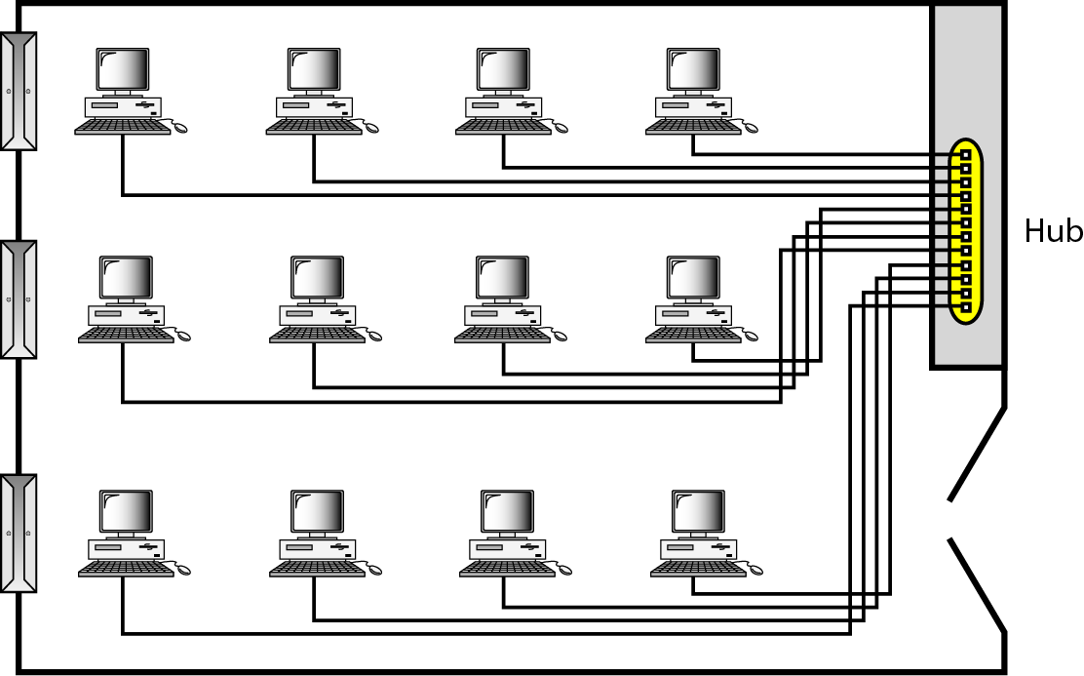
LAN

Slide 38
Wide Area Networks (WAN)
Large geographical area
Connect LANs
Usually Public but may be Private
Slower than LAN
Consist of interconnected switching nodes
Switching nodes have no concern with data
Just meant for providing switching facility toward destination

Slide 39
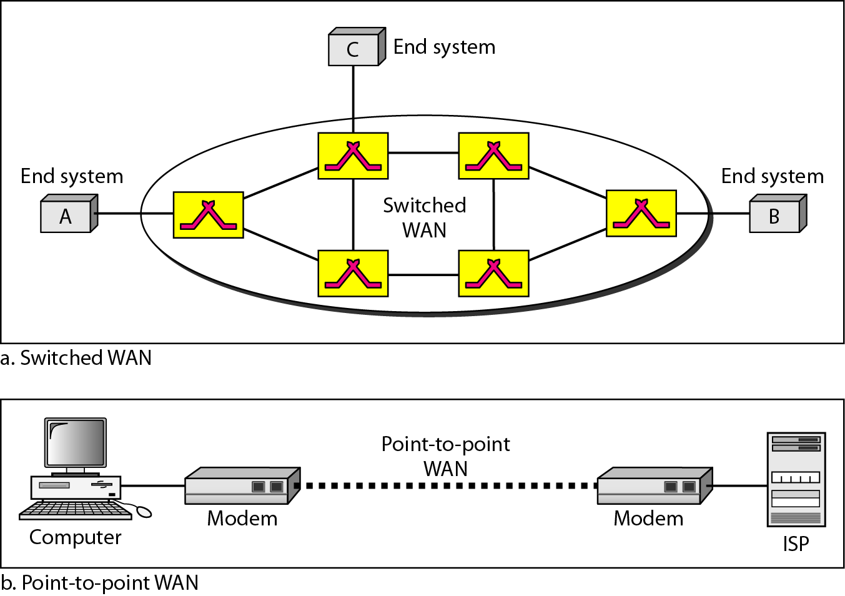
WAN

Slide 40
Notes:
heterogeneous network made of four WANs and two LANs

Slide 41
A Typical Network Configuration

Slide 42
Reading Assignment
Some types of networks have been discussed like LAN and WAN. You are required to learn about other network configurations including:
WAN (Wide Area Network)
LAN (Local Area Network)
WLAN (Wireless Local Area Network)
MAN (Metropolitan Area Network)
SAN (Storage Area Network)
CAN (Campus/Controlled/Cluster Area Network)
PAN (Personal Area Network)
Note: All reading assignments are part of course
Notes:
Wlan:A WLAN typically extends an existing wired local area network. WLANs are built by attaching a device called the access point (AP) to the edge of the wired network. Clients communicate with the AP using a wireless network adapter similar in function to a traditional Ethernet adapter.
A WLAN allows users to move around the coverage area, often a home or small office, while maintaining a network connection.
SANA storage area network (SAN) is any high-performance network whose primary purpose is to enable storage devices to communicate with computer systems and with each other

Slide 43
Types of Networks
Client Server Networks
Peer To Peer Networks

Slide 44
Client Server Implementation
Servers are distinguished from other systems which are known as clients and all these are connected over a computer network
Servers offer services which are used by client systems
Server serves clients
Server always keep listening for clients
A Server could be used for
Data Storage
Distributed Application
Resource Sharing
Authorization
Accountancy
Security & easy Administration
Centralized Control
A Server may require clients to log on before any services may be provided

Slide 45
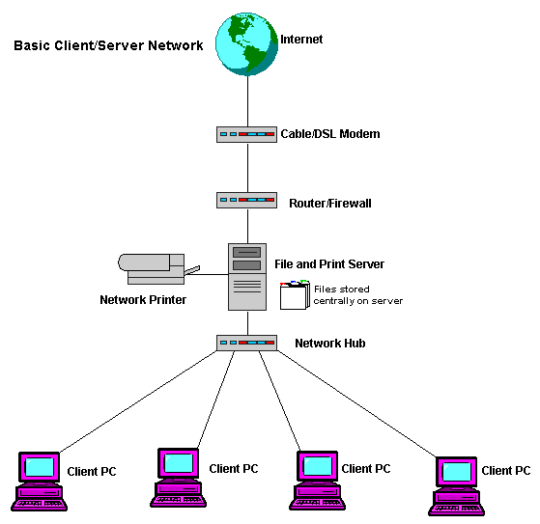
Client Server Implementation

Slide 46
Client Server Implementation
What is the difference in Servers and Clients
Physically Different
Separate Kind of Machines?
Actual Difference in Software
Server runs server software while client runs software module (usually very small in comparison to server software)
Used Yahoo Messenger?
You have a very tiny module of Yahoo Messenger (Clients)
Actual Yahoo Messenger Server S/W is much heavy

Slide 47
Client Server Implementation (Advantages)
Centralized Control
Security Policies are easily implemented
Logs could be create
Reliability
Easy to share resources
Stable environment (Both H/W and S/W)
Performance degrade gracefully in higher loads

Slide 48
Client Server Implementation (Disadvantages)
Costly to install
Usually require Expert personnel to manage

Slide 49
Peer-to-Peer Networks
Each computer serves both as client as well as server
No centralized control for user access
Usually useful for SOHO (Small Office/Home Office)

Slide 50
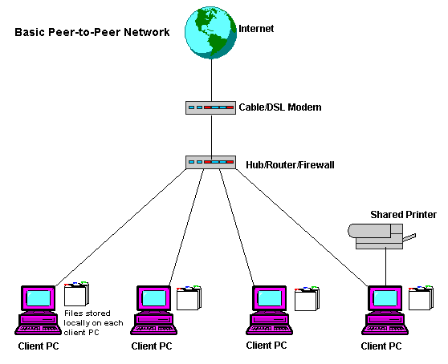
Peer-to-Peer Networks

Slide 51
Peer-to-Peer Networks Advantages
Easy to setup
Low H/W, S/W cost
Usually useful for file/print/internet sharing
Useful in environments where security is not an issue

Slide 52
Peer-to-Peer Networks Disadvantages
Not Reliable
Performance degrade exponentially as new nodes add into the network
Compromised network security

Slide 53
Network Models
Computer networks are created by different entities.
Standards are needed so that these heterogeneous networks can communicate with one another.
The two best-known standards are the OSI model and the Internet (TCP/IP) model.
The OSI (Open Systems Interconnection) model defines a seven-layer network
The Internet model(TCP/IP) defines a five-layer network.

Slide 54
Topics For the Next Class
Internet
Software Defined Networks SDN

Slide 55
References
Data Communication and Computer Networks by Behrouz A Forouzan.pdf
Data And Computer Communications by William Stallings.pdf
https://www.academia.edu/37562829/INTRODUCTION_TO_COMPUTER_NETWORKS

